Slide 1
Introduction to Azure API Management

Slide 2
welcome.

Slide 3
introduction to azure api management.

Slide 4
and you are?

Slide 5
IT Pro or Developer?

Slide 6
let’s talk about apis and how they can boost your business

Slide 7
Extending a platform
API
developers
new channels, more customers
partners
employees

Slide 8







“In little more than a decade, APIs have transitioned from relative obscurity to become the ‘digital glue’ that empowers developers to create new software applications, partnerships and even new businesses. This business-to-developer market is quickly becoming one of the fastest growing opportunities within cloud computing”
Byron Deeter, partner at Bessemer Venture Partners. Investor in Box, DocuSign, Twilio and SendGrid.
http://venturebeat.com/2013/08/31/api-economy/

Slide 9
Business models
direct monetization
public
private
Indirect monetization

Slide 10
So you want an API program?
How do you engage with developers?
How do you reduce TTFSC?
How do you enforce your business policies?
How do you make your legacy API modern?
How do you understand their behavior?
How do you protect your core business systems?
API Management

Slide 11

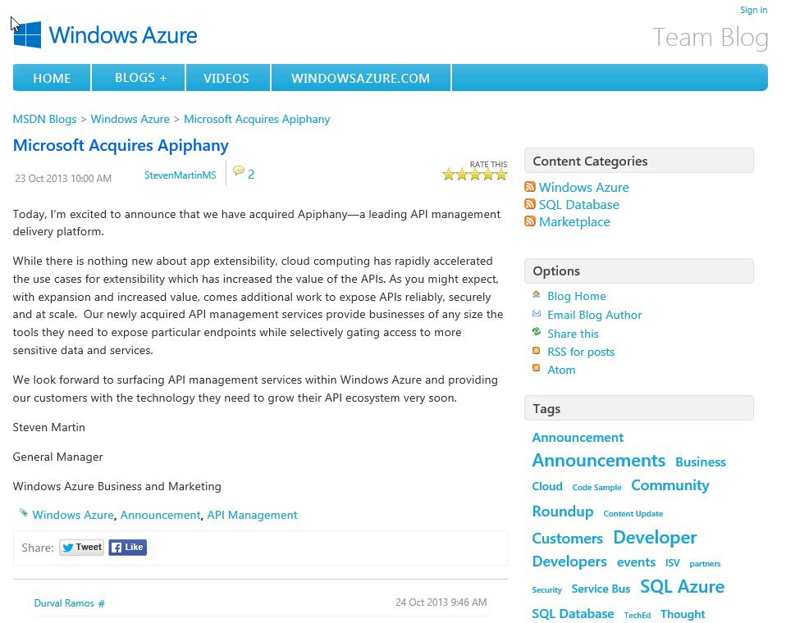
October 23, 2013

Slide 12

AZURE API MANAGEMENT

Slide 13
Microsoft Azure API
DEVELOPER PORTAL
DEVELOPERS
PROXY
API
APPS
PUBLISHER
PORTAL
Can be hosted anywhere and authored in any language on any platform.
PUBLISHER / ADMIN
AZURE API
MANAGEMENT

Slide 14
Demo: Azure API Management
Notes:
Demo flow can be found at http://channel9.msdn.com/Events/TechEd/NorthAmerica/2014/DEV-B351

Slide 15
much preview, nice feature
Developer Experience
Self-Registration
Subscriptions
Documentation
Console
Issues Forum
Dashboard
Proxy & Policies
Call and bandwidth quotas
Rate limit
Caching
HTTPS
Authenticate with Basic
CORS / x-domain calls
Find and replace string
Re-write URL
Mask URLs
JSONP
JSON to/from XML
Set header or parameter
IP filter
Wildcard operations
Security
Custom developer ID
Social Developer ID
API key authentication
Basic Authentication
Reports
Calls
Bandwidth
Cache hits/misses
Status codes
API and service response time
Proxy response time
Filter any report by product API Operation
Admin Experience
API specification
Product management
Policies Editor
Developer management
Content management
Configurable notifications

Slide 16

preview available in azure right now (go try)
updates already in the pipeline
… and more coming regularly
keen to engage with customers
reach us at apimgmt@microsoft.com

Slide 17
Q&A

Slide 18


Get started
Visit azure.microsoft.com

